Slide 1



Sentiment Analysis of Google Play Store Reviews
Using BERT
CSCI B-565 Project Presentation
By:
Advait Hirlekar
Amogh Amin
Rutuja Jangle

Slide 2

Index
Introduction
Motivation & Goals
Dataset Overview
Data Preprocessing
Fine Tuning the Model
Results and Evaluation
Conclusion
References

Slide 3

Introduction
What is Sentiment Analysis?
Sentiment analysis helps understand user feedback from reviews, surveys, and social media.
It is very crucial for app developers and stakeholders to track user satisfaction in order for app improvement.
Why do traditional methods do not work in Sentiment Analysis?
Traditional methods (SVM, Naive Bayes) struggle with complex language in user reviews.
Lack of contextual understanding makes them less effective.
Introducing BERT
BERT's bidirectional training allows it to understand the context of the entire sentence, making it ideal for analyzing informal language in reviews.
By using BERT, we can improve sentiment classification accuracy in reviews, guiding better app improvements.

Slide 4

Motivation and Goals
Some valuable motivations associated with using Sentiment Analysis are as follows:
Understanding User Feedback: Google Play Store reviews are a treasure trove of user opinions. Sentiment analysis allows businesses to tap into these valuable insights and gauge how users feel about their apps, identifying areas of strength and areas for improvement.
Improving User Experience: Developers can make data-driven decisions to refine app features and resolve user issues, enhancing overall satisfaction.
Enhancing Decision Making: Businesses can prioritize updates based on user sentiment, responding to feedback faster than ever before, improving app quality and keeping users engaged.
Staying Ahead of Competitors: Real-time sentiment analysis provides a competitive edge, allowing businesses to address concerns quickly and adapt to evolving user needs.

Slide 5
Some valuable goals that can be obtained using this technique are as follows:
Automate Sentiment Classification: We can use machine learning models to classify reviews as positive, neutral, or negative, making it easier for developers to identify the sentiment behind user feedback at scale.
Track Sentiment Trends: Monitor changes in user sentiment over time to evaluate the impact of new updates and identify which aspects of the app need improvement.
Prioritize key issues: Identify recurring complaints or issues highlighted by users, enabling the team to prioritize fixing bugs or enhancing features that matter most to the users.
Enhance App Strategy: Leverage sentiment insights to drive marketing and development decisions, ensuring the app aligns with user needs and preferences.

Slide 6
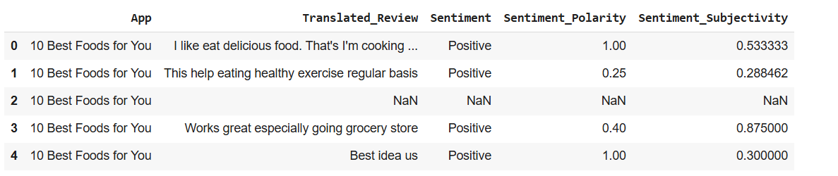
Dataset Overview
The dataset schema is as follows:
The dataset has 64295 instances and 5 attributes.

Slide 7
Data Preprocessing
Tokenization: The text is split into individual words using word_tokenize. This step is crucial for converting raw text into manageable pieces that can be processed further.
Removing Stopwords: Commonly used word such as “and”, “the”, “is” etc which do not contribute significant meaning to the analysis are removed using the stopwords corpus. This helps the model focus on more meaningful words in the text.
Lemmatization: Words are reduced to their base or root form using the ‘WordNetLemmatizer’. For example ‘running’ becomes ‘run’, helping to standardize the text and reduce variations of the same word to one form.
Balancing Techniques: We proceeded to check the number of classes present in each category. It is important to know this because if the data is skewed while training the model, the model gets less exposure to examples which are less in number.

Slide 8
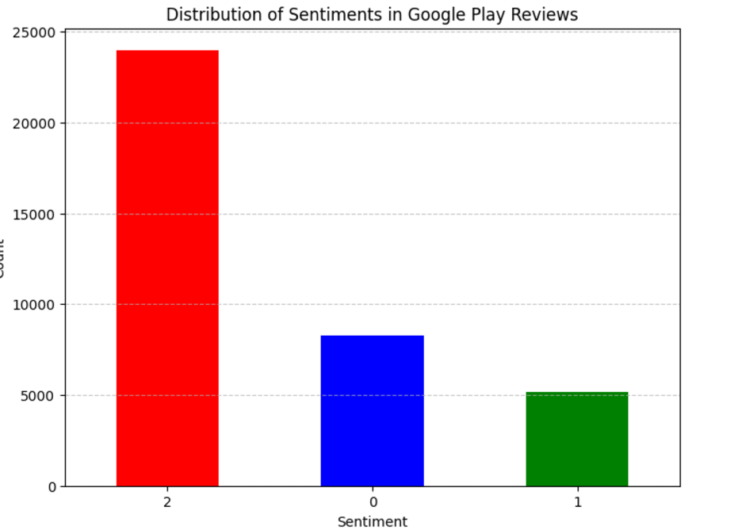
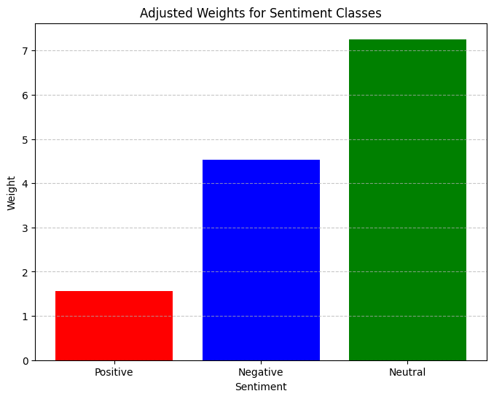
Before After
From this we can clearly see that the number of negative reviews is much less than the positive ones.
We addressed this issue by In this code, different weights are assigned to each class by calculating the inverse frequency of each class (class_weights) and passing these values to the CrossEntropyLoss function, ensuring that the model places more emphasis on underrepresented classes.

Slide 9
Fine Tuning the Model
We fine-tuned the BERT model using the training data for 10 epochs.
During each epoch, the model's weights were updated based on the computed loss, which incorporated class weights for balanced training.
The class weights were calculated to address the class imbalance in the dataset, ensuring the model places more emphasis on underrepresented classes, such as negative reviews.
The model's performance was evaluated on the validation set after each epoch, and the loss values were tracked to monitor the model's progress.
This fine-tuning process, combined with weighted loss, helped the model better generalize to all classes, improving its overall sentiment classification accuracy.

Slide 10
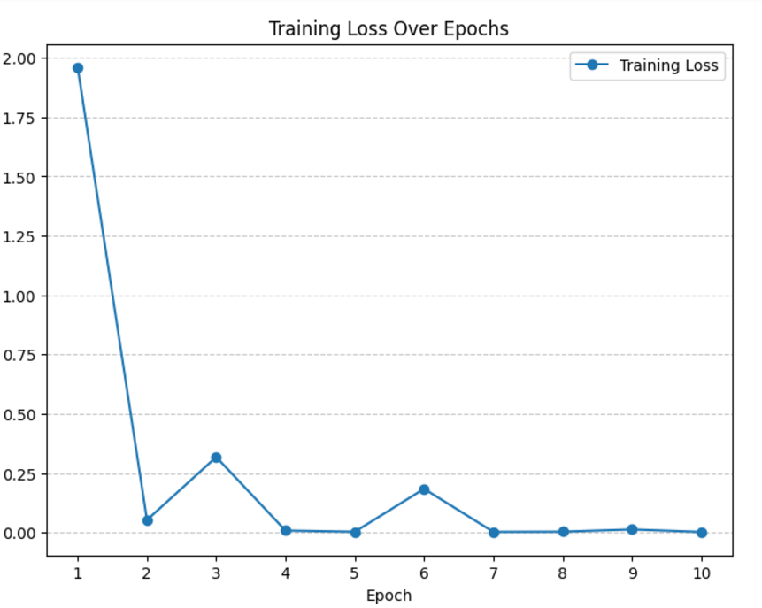
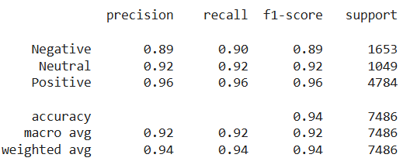
Results and Evaluations
Fig 1: Training loss over 10 epochs Fig 2: The classification report for the model

Slide 11
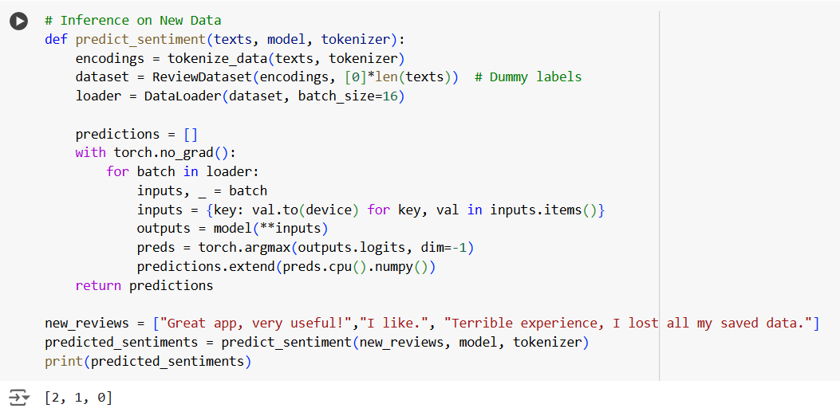
We also tested our model on 3 new examples to see whether our model performs successful sentiment analysis:
Like earlier here also we have taken positive as 2, negative as 1 and neutral as 0.
Thus from the above example we can clearly see that our model performs perfectly on new data.

Slide 12
Conclusion:
The fine-tuned BERT model achieved an overall accuracy of 94%, with high precision, recall, and F1-scores across all sentiment classes. Notably, the model performed exceptionally well in classifying both the positive and neutral sentiments, achieving an F1-score of 0.96 and 0.92, respectively, while maintaining robust performance on the underrepresented negative class with an F1-score of 0.89. These results demonstrate that the incorporation of class weights effectively addressed class imbalance, enabling the model to generalize well across all sentiment categories and deliver reliable predictions.

Slide 13
References
[1] Devlin, J., Chang, M. W., Lee, K., & Toutanova, K. (2019). BERT: Pre-training of Deep Bidirectional Transformers for Language Understanding. In Proceedings of NAACL-HLT 2019(pp. 4171–4186). Association for Computational Linguistics.
[2] Mikolov, T., Chen, K., Corrado, G., & Dean, J. (2013). Efficient Estimation of Word Representations in Vector Space. arXiv preprint arXiv:1301.3781.
[3] Vaswani, A., Shazeer, N.M., Parmar, N., Uszkoreit, J., Jones, L., Gomez, A.N., Kaiser, L., & Polosukhin, I. (2017). Attention is All you Need. Neural Information Processing Systems.
[4] Googleplaystore_user_reviews.csv https://www.kaggle.com/code/gallo33henrique/llmengineering-prompt-sentiment-analysis/input?select=googleplaystore_user_reviews.csv
[5] Joachims, T. (1998). Text categorization with Support Vector Machines: Learning with many relevant features. Machine Learning: ECML-98, 137–142.

